Slide 1
Lec -3
INTRODUCTION
(Network hardware architecture and its topologies and
device like HUB, Switch and Routers)

Slide 2
Categories of Networks
•Personal area networks .
•Local Area networks .
•Metropolitan Area networks .
•Wide Area networks .
•Wireless Networks .
•Home Networks .
•Internetworks-The Internet .

Slide 3
Local Area Network (LAN)
Local Area Network (LAN)
LAN is the most frequently used network. A LAN is a computer network that connects computers through a common communication path, contained within a limited area, that is, locally. Examples of LAN are networking in a home, school, library, laboratory, college, office, etc.

Slide 4
Local Area Networks (LANs) Wireless and wired LANs. (a) 802.11. (b) Switched Ethernet.

Slide 5
Isolated LAN connecting 12 computers to a hub in a closet.

Slide 6
Personal Area Network (PAN)
PAN is the most basic type of computer network. This network is restrained to a single person, that is, communication between the computer devices is centered only on an individual’s workspace. PAN offers a network range of 1 to 100 meters from person to device providing communication. Its transmission speed is very high with very easy maintenance and very low cost.
Examples of PAN are USB, computer, phone, tablet, printer, PDA, etc.

Slide 7
Personal Area Network - Bluetooth PAN configuration.

Slide 8
Wide Area Networks (WANs). WANs: a switched WAN and a point-to-point WAN.

Slide 9
1.8 -A heterogeneous network made of four WANs and two LANs.

Slide 10
Metropolitan Area Networks (MANs)- Provide connectivity over areas such as a city, a campus A metropolitan area network based on cable TV or telephone cable using DSL

Slide 11
Wireless Networks . •(a)Bluetooth configuration •(b)Wireless LAN

Slide 12
Wireless Networks. (a)Individual mobile computers (b)A flying LAN

Slide 13
Home Network Categories.
Computers(desktop PC ,PDA ,shared peripherals
• Entertainment(TV,DVD,VCR,camera,stereo,MP3)
•Telecomm(telephone, cellphone,intercom ,fax)
•Appliances( microwave, fridge, clock, furnace, airco)
•Telemetry( utility meter, burglar alarm, babycam).

Slide 14
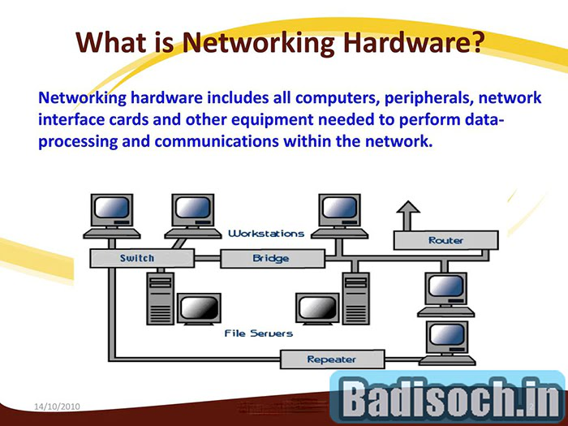
What is Network hardware architecture ?

Slide 15
What is Internet ?
It is a collection of two or more networks .
The Internet is called a globally connected network system that facilitates communication and data services through a vast collection of private, public, business, academic, and government networks.
It is a collection of millions of computers, webpages, websites, and servers.
Using the internet we can send emails, photos, videos, messages to our loved ones.

Slide 16
Network Topology.

Slide 17
A fully connected mesh topology .

Slide 18
What is mesh topology?
A mesh topology is a type of computer network in which each node (computer or other device) is connected to every other node in the network.
This type of network is often used in large organisations or companies because it can handle a large amount of data traffic and can be easily expanded.

Slide 19
Advantages of Mesh .
1. High-level traffic management of mesh topology: -
There is no hierarchical relationship exists between mesh topology. For instance, let us consider a device that is connected to it and attempts to contact any other one by directly taking advantage of the routing ability of the device. In this case, it will be able to do it.
2. Failure of one single device does not affect the network:-
When the mesh topology is resistant to problems, it is exceptional. All the notes after the network translate and receive the information within it. With sufficient redundancy, the structure provides its users that they can keep it in running condition even if some malfunction occurs. If one of the nodes malfunctions, then the network has the strength to use other nodes and complete the mesh.

Slide 20
Disadvantages of mesh topology.
1. High cost:-
The implementing cost in this topology is very high compared to others. This is due to the requirement of various parts of very extensive equipment. To operate correctly, we need to have all the hardware, Internet bandwidth, cabling, etc., connected properly.
2. High risk of redundant connection:-
Due to a large number of networks can be handled by miss topology, it is a chance of setting redundant connections.

Slide 21
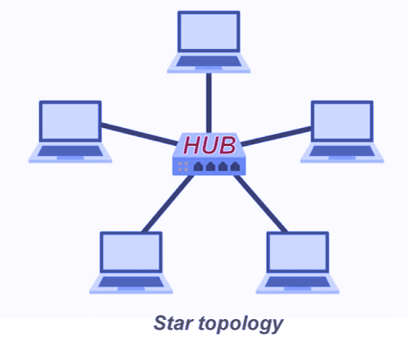
Star topology .
Star topology is a network topology in which each network component is physically connected to a central node such as a router, hub or switch. In a star topology, the central hub acts like a server and the connecting nodes act like clients.

Slide 22
Advantages of Star Topology .
1. User friendly:
Without affecting the rest of the network, the new nodes can be added easily to the star topology. In that manner, we can easily remove the components in it. So it is convenient to add more computers to the network. It also becomes easier to replace a damaged unit to maintain our productivity levels.
2. Centralized network:
The network is monitored with the help of a centralized management system using the hub, central computer, or switch.
3. Very reliable:
When a device or a cable fails, then the other devices which are connected to it will Work. Hence the rest of the network is not affected by the failure of one node or link.
4. Highly efficient:
Within the star topology, when each device is connected to the central core with the help of cables, then the chances of collision of data are relatively lower. From that, it means the system's performance level is higher than expected compared to other network designs.

Slide 23
Disadvantages of Star Topology:
1. High cost: -
Within the star topology implementation of a router or switch, it's very costly, especially when using a router or a switch as the central network device.
2. Central device Dependency:-
Within the star topology, when a hub malfunctions, then everything goes down because no devices can work without a hub. The main negative point in this whole network is when the central device goes down or fails, the whole system goes down.
3. High maintenance:-
Within the star topology, regular maintenance and more resources are required by the hub because it is the central system of the star.

Slide 24
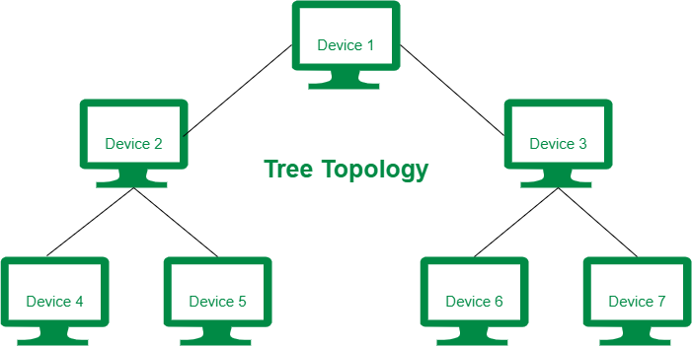
Tree Topology

Slide 25
How tree topology works.

Slide 26
What is Tree Topology?
Tree topology is define as geometrical representation of devices in a network, that are connected to each other in such a way that, it forms a tree like structure.
Tree Topology is an classic example of hybrid topology.
A hybrid topology is a combination of two or more computer network topologies.

Slide 27
Advantages of Tree Topology :-
Advantages
This topology is the combination of bus and star topology.
This topology provides a hierarchical as well as central data arrangement of the nodes.
As the leaf nodes can add one or more nodes in the hierarchical chain, this topology provides high scalability.
The other nodes in a network are not affected if one of their nodes gets damaged or does not work.

Slide 28
Disadvantages of Tree Topology :-
This network is very difficult to configure as compared to the other network topologies.
The length of a segment is limited & the limit of the segment depends on the type of cabling used.
Due to the presence of a large number of nodes, the network performance of tree topology becomes a bit slow.
If the computer on the first level is erroneous, the next-level computer will also go under problems.

Slide 29
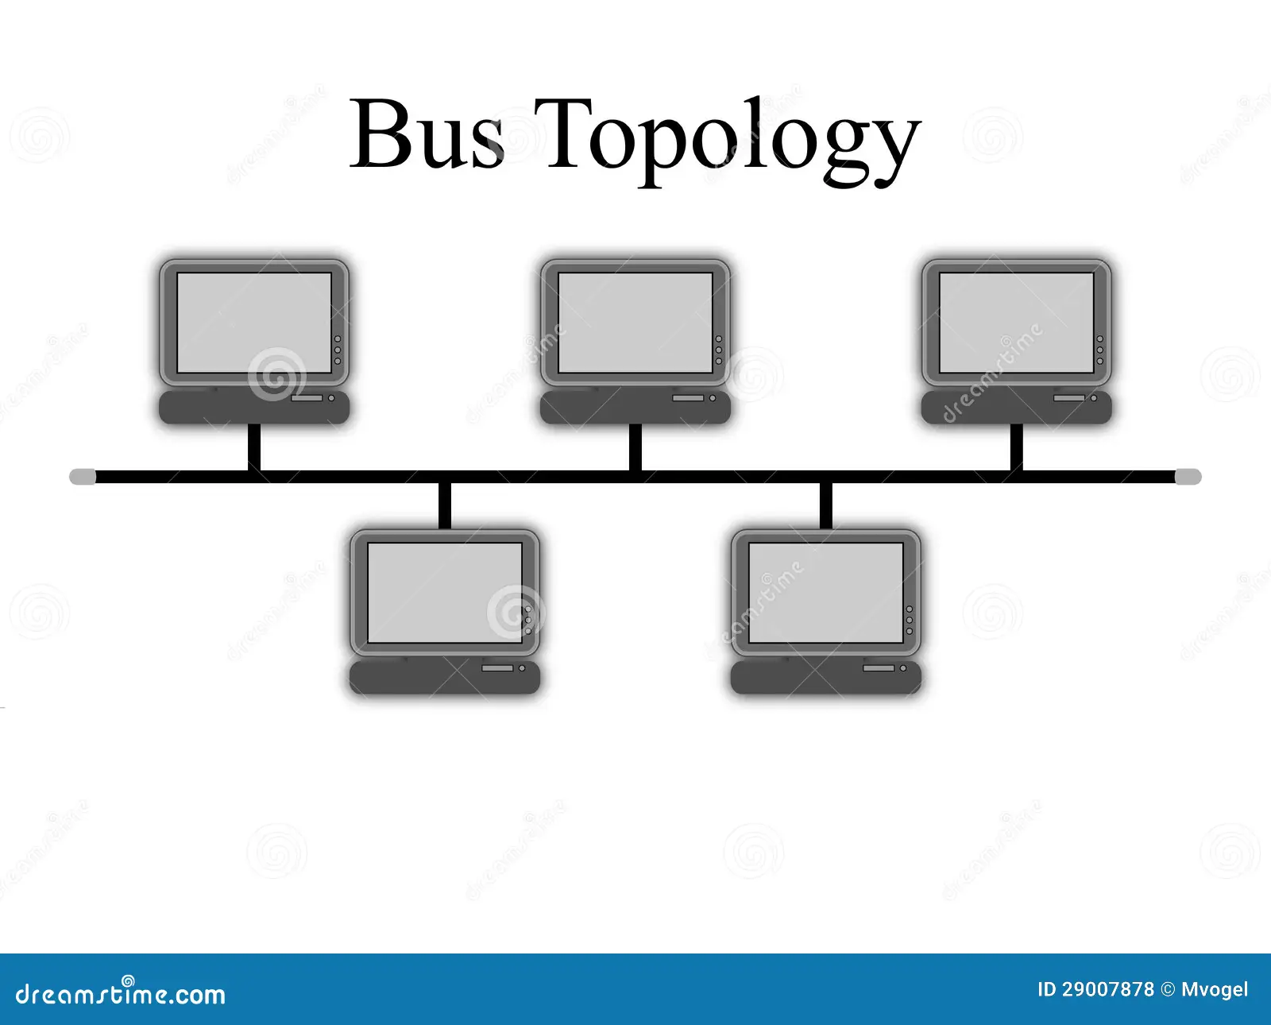
Diagram of Bus Topology.

Slide 30
How bus topology works.

Slide 31
Advantages of bus topology .
In the bus topology every computer is linked to a single connection line or cable through an interface and each computer can directly communicate with other computer or device in the network.
Advantages of tree topology.
1. Cheaper than other Alternative Topologies -
Compared to the other network topologies such as mesh, star or tree topology available to establish the network. It is cheaper as it does not require any additional device to set up. Moreover, the cable length required to establish bus topology is also comparatively less.

Slide 32
Advantages of bus topology.
Easy to Establish Bus Topology-
The user can easily use an Ethernet cable and some connectors to connect the nodes in the network. It is simple to establish bus topology as the nodes are connected using drop cables with the bus cable. The nodes are linked linearly, requiring minimum time to establish bus topology.
Easy to Attach Multiple Nodes
The user can easily connect different types of nodes in the network. The operation of the nodes is simpler in the network. It also enhances the team's productivity by allowing them to use different types of nodes in the network.

Slide 33
Ring Topology

Slide 34
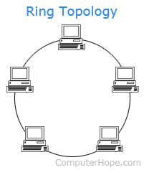
How ring topology works .
Ring topology is a type of network configuration in which each device on the network is connected to two other devices, forming a “ring.” Data travels around the ring in one direction only, from device to device, until it reaches its destination.

Slide 35
Advantages of Ring topology .
In this data flows in one direction which reduces the chance of packet collisions.
In this topology additional workstations can be added after without impacting performance of the network.
Equal access to the resources.
There is no need of server to control the connectivity among the nodes in the topology.
It is cheap to install and expand.
Minimum collision.

Slide 36
Disadvantages of Ring topology .
Due to the Uni-directional Ring, a data packet (token) must have to pass through all the nodes.
If one workstation shuts down, it affects whole network or if a node goes down entire network goes down.
It is slower in performance as compared to the bus topology.
It is Expensive.
Addition and removal of any node during a network is difficult and may cause issue in network activity.
Difficult to troubleshoot the ring.

Slide 37
What is Hybrid Topology ?

Slide 38
Hybrid topology is a type of network topology in which two or more different topologies are integrated or combined to lay out a network.
A hybrid topology is a kind of network topology that is a combination of two or more network topologies, such as mesh topology, bus topology, and ring topology. Its usage and choice are dependent on its deployments and requirements like the performance of the desired network, and the number of computers, their location.

Slide 39
How to Connect different devices on layers.

Slide 40
Different networking devices are-
1. Repeater – A repeater is a network device which operates at the physical layer.
Its main function is to regenerate the signal over the same network before the signal becomes too weak or corrupted to extend the length to which the signal can be transmitted over the same network.
2. Hub – It works on physical layer . A hub is a basically multi-port repeater. A hub
connects multiple wires coming from different branches.
Types of Hub
Active Hub:- These are the hubs that have their power supply and can clean, boost, and relay the signal along with the network. It serves both as a repeater as well as a wiring center. These are used to extend the maximum distance between nodes.
Passive Hub:- These are the hubs that collect wiring from nodes and power supply from the active hub. These hubs relay signals onto the network without cleaning and boosting them and can’t be used to extend the distance between nodes.
Intelligent Hub:- It works like an active hub and includes remote management capabilities. They also provide flexible data rates to network devices. It also enables an administrator to monitor the traffic passing through the hub and to configure each port in the hub.

Slide 41
Gateway – A gateway, as the name suggests, is a passage to connect two networks that may work upon different networking models. They work as messenger agents that take data from one system, interpret it and transfer it to another system. Gateways are also called protocol converters and can operate at any network layer.
Brouter – It is also known as the bridging router is a device that combines features of both bridge and router. It can work either at the data link layer or a network layer. Working as a router, it is capable of routing packets across networks and working as the bridge, it is capable of filtering local area network traffic.

Slide 42
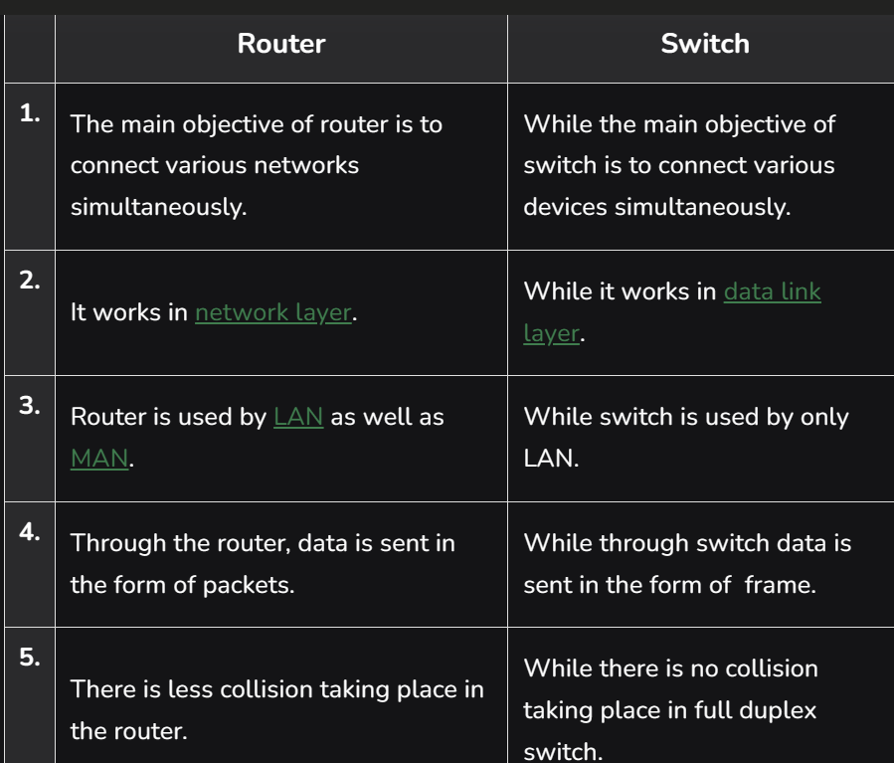
Difference between Router and Switch

Slide 43
Diagram of Hub .

Slide 44
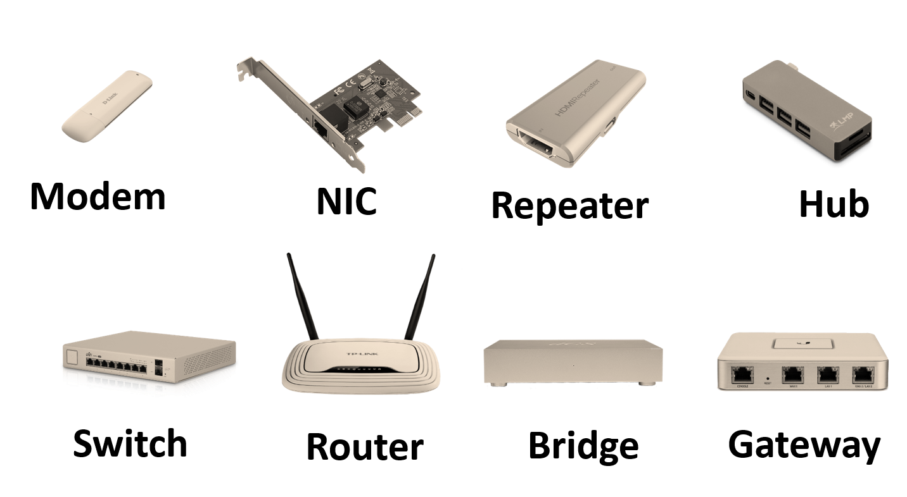
Original View of Networking devices.

Slide 45
Repeater are connected in Ring Topology.

Slide 46
Thanks

